Slide 1


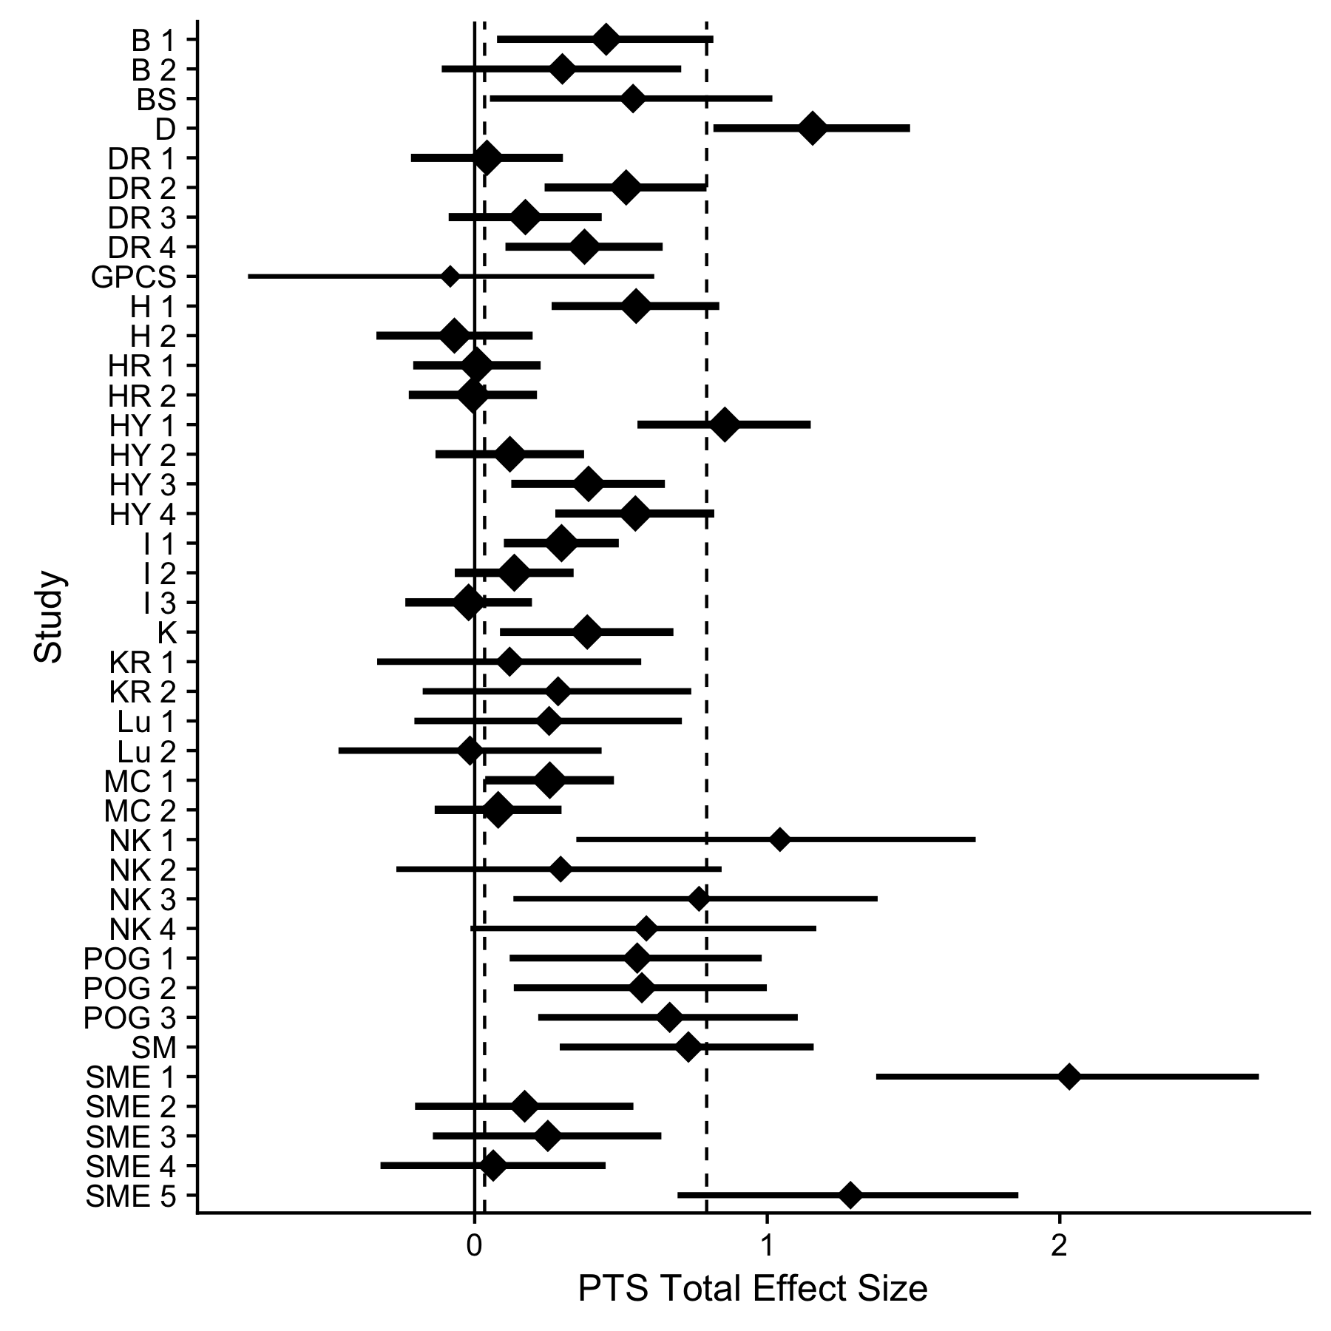
A Meta Analysis of Expressive Writing on Posttraumatic Stress
[Title]
[Title]
Jeffrey Pavlacic, BS, Erin Buchanan, PhD, & Stefan E. Schulenberg, PhD
INTRODUCTION
RESULTS
DISCUSSION
Posttraumatic Stress Disorder (PTSD) is characterized by re-experiencing thoughts or events after a traumatic event. This generates a context in which individuals are prone to maladaptive responding (e.g. avoidance) and affect-related deficiencies.
The subsets of symptoms that characterize DSM-IV PTSD criteria are as follows: re-experiencing, avoidance, negative alterations in cognition and mood, and arousal.
Emotional expression has been shown to be beneficial for enhancing physical and psychological outcomes, while repressing negative emotions can lead to impairments in physical and psychological health.
James Pennebaker found that expressive writing interventions are an effective form of emotional expression.
A majority of the studies conducted employing expressive writing as an intervention tend to neglect necessary considerations, such as power and meaningfulness of respective effect sizes.
No meta-analysis has examined the effectiveness of expressive writing focusing only on changes in experimental conditions. Additionally, this current meta-analysis sought to use random and fixed effects models to provide the reader with a comprehensive overview of the effects of expressive writing on posttraumatic stress (PTS) on only the experimental group conditions.
Studies employing PTS as an outcome indicated a small effect size across all meta-analytic estimates. Methods also indicated that this effect is likely not different from zero.
If participants/clients are not deeply engaged in the material, the intervention may not be as effective. Indeed, Pennebaker & Graybeal (2001) imply that connectedness is an important factor in promoting behavior change.
Additionally, studies show that instructions for delivering such interventions vary widely, which may contribute to mixed findings in the literature.
This study did not find evidence of publication bias.
Although a relationship between effect size and time was not supported, PTS indicated a small, negative correlation. This indicates that the effect of the intervention decreased over time, albeit not significantly.
The psychological scientific community has shifted focus to reproducibility and research design in the past several years, with much of this discussion focusing on adequately powered studies for publication. The current “replication crisis” may be attributed to lower power in published studies.
The power in the current meta-analysis was poor, with very few studies reaching the suggested 80% criterion to adequately power their study. This result was the same when considering individual study characteristics or the estimate of the true population effect size.
Despite these limitations, this meta-analysis allows researchers to examine the state of the research in regards to expressive writing. Potential with expressive writing on reducing PTS symptoms was found, although there exists a need for adequate sample size and power planning for studies.
METHOD
Studies were recruited through online databases, such as PsychINFO and Google Scholar using the following search terms: Posttraumatic Stress, PTS, Expressive Writing, and Emotional Disclosure.
Only participants assigned to the experimental condition were examined.
The majority of the studies included an experimental vs. control group condition. However, only the experimental groups were considered to examine the magnitude of the change across such groups.
Additionally, relationships across multiple time points were examined (i.e. did the symptoms resurface after a significant period of time).
220 total citations were identified, and 144 effects were calculated for PTS. A complete list of excluded articles may be found at https://osf.io/4mjqt, as well as justification for their exclusion.
Effect sizes were calculated using Cohen’s d in R. Additionally, both fixed and random effects models were calculated. Newer statistical techniques designed to control for publication bias were also conducted, such as p-curve, p-uniform, PET-PEESE, Selection Models, and Trim and Fill. Finally, power and homogeneity were calculated.
Model | Fixed Effects Outliers | Random Effects Outliers | Fixed Effects No Out | Random Effects No Out
Overall Effects | 0.34 [0.31, 0.37] | 0.39 [0.32, 0.46] | 0.32 [0.29, 0.35] | 0.36 [0.29, 0.42]
Z Values | 21.75, p < .001 | 11.06, p < .001 | 20.00, p < .001 | 11.03, p < .001
p-Uniform | 0.60 [0.50, 0.71] | - | 0.57 [0.47, 0.67] | -
PET | 0.12 [0.03, 0.21] | - | 0.11 [0.02, 0.20] | -
PEESE | 0.25 [0.20, 0.30] | - | 0.23 [0.18, 0.28] | -
Selection Models | 0.33 [0.28, 0.37] | 0.45 [0.33, 0.57] | 0.29 [0.24, 0.33] | 0.39 [0.27, 0.50]
Trim and Fill | 0.26 [0.23, 0.29] | 0.26 [0.18, 0.34] | 0.25 [0.22, 0.28] | 0.25 [0.18, 0.32]
REFERENCES
For a complete list of references, as well as a pre-print of the manuscript submitted for publication, please contact Jeffrey Pavlacic at jpavlaci@go.olemiss.edu.

